Slide 1

Car performance prediction

Slide 2
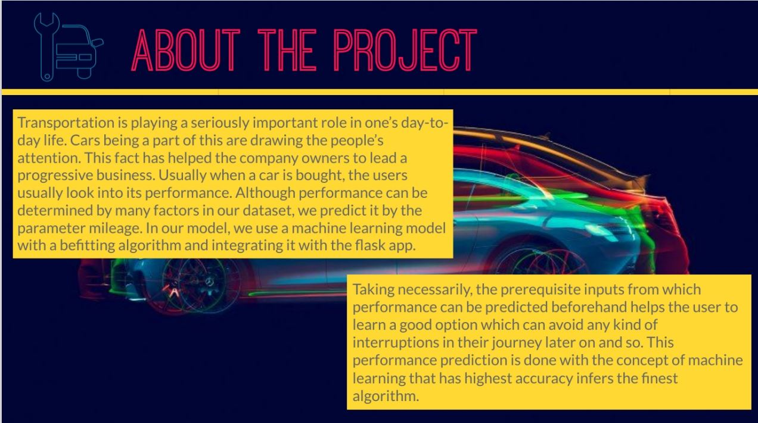

Slide 3
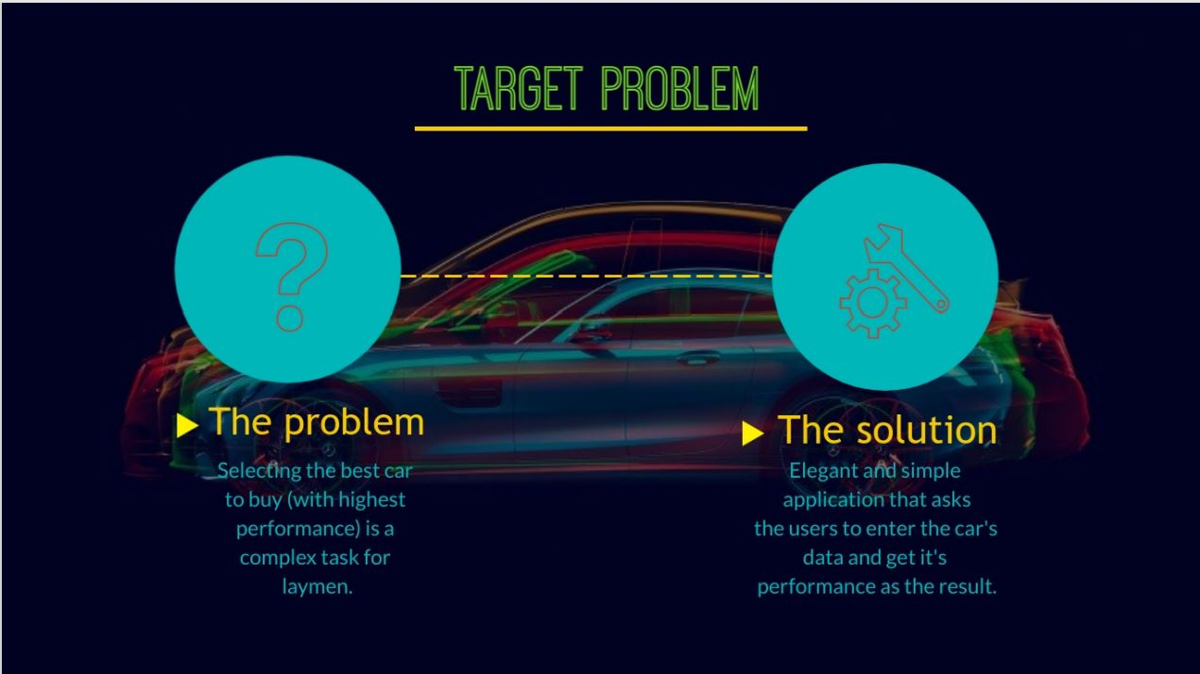

Slide 4
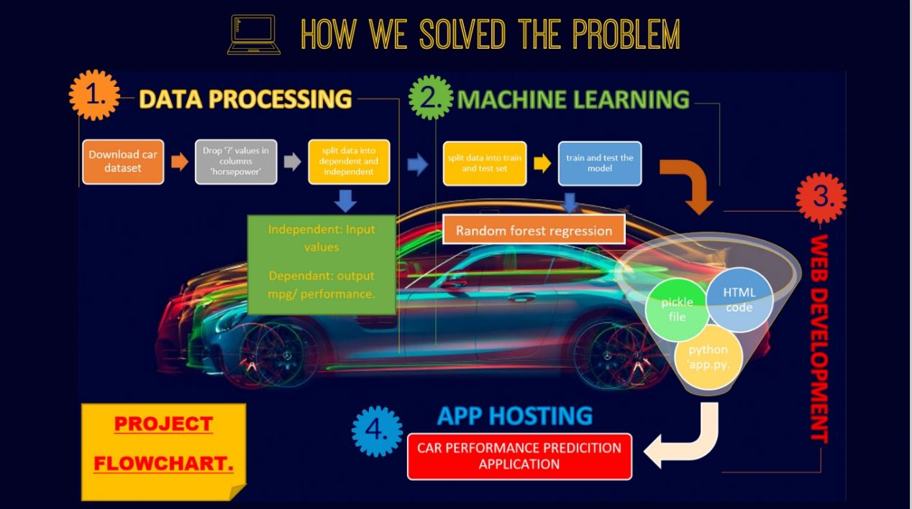

Slide 5
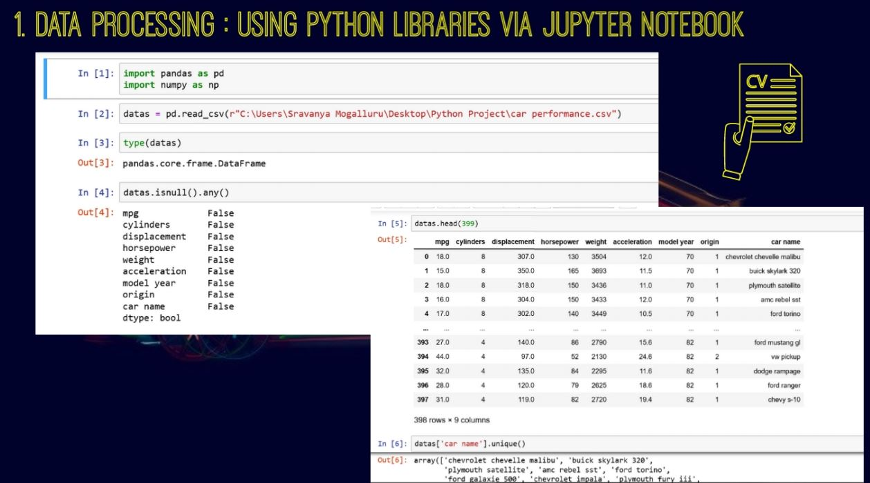

Slide 6
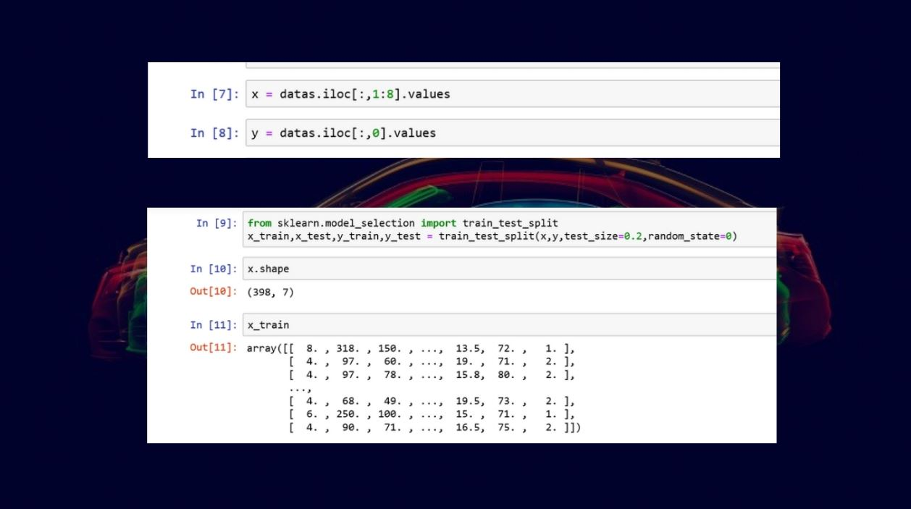

Slide 7
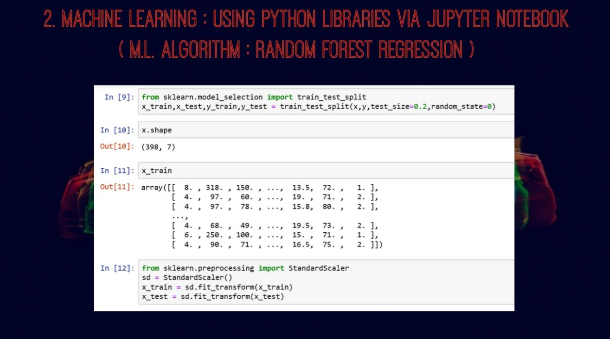

Slide 8
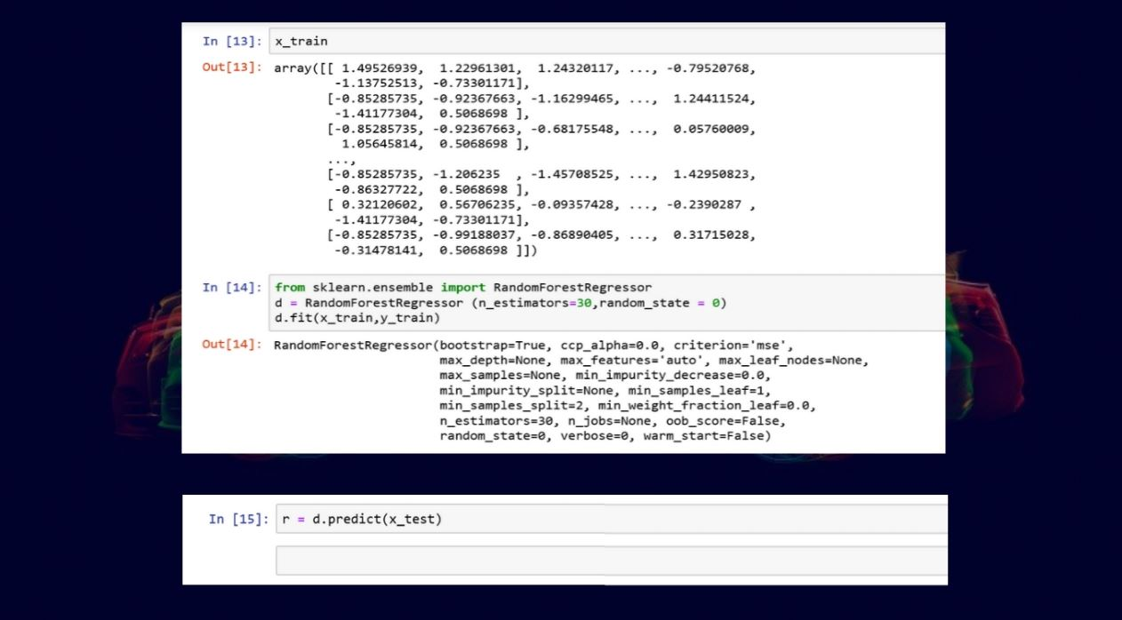

Slide 9
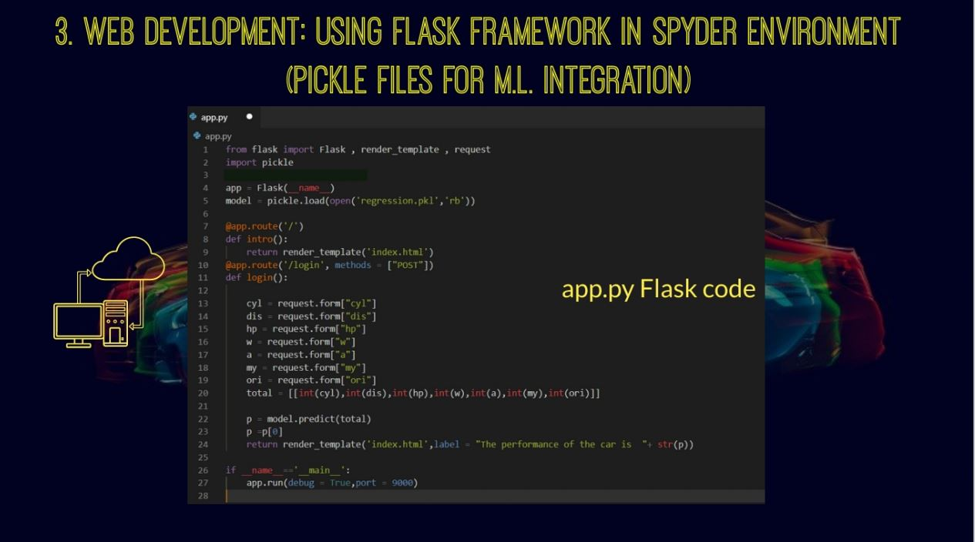

Slide 10
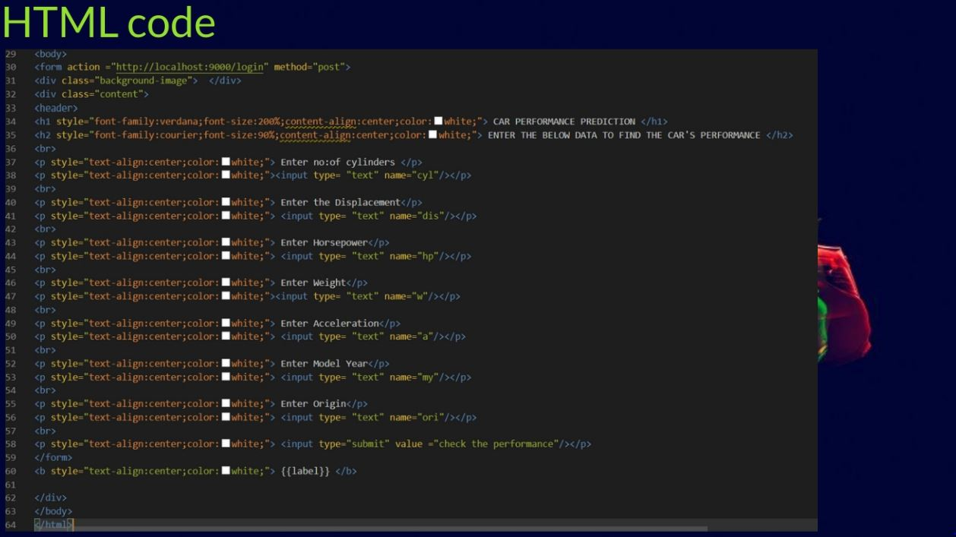

Slide 11
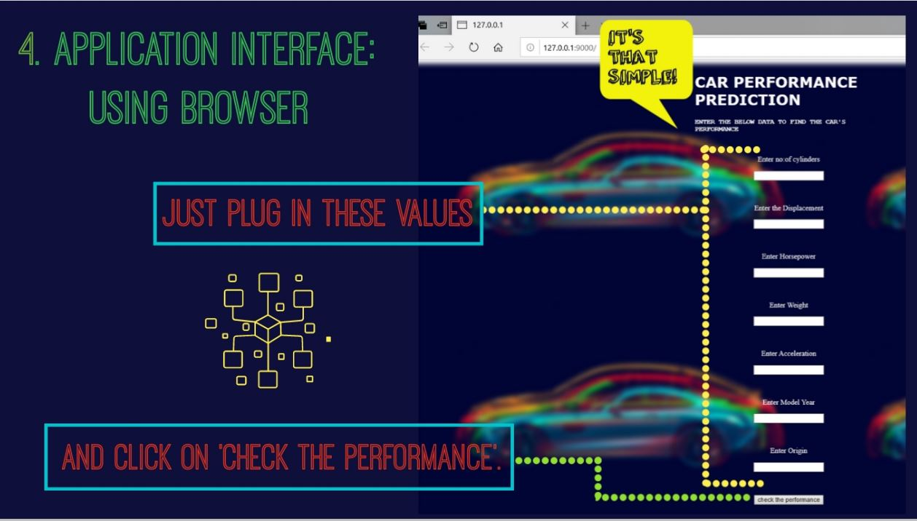

Slide 12
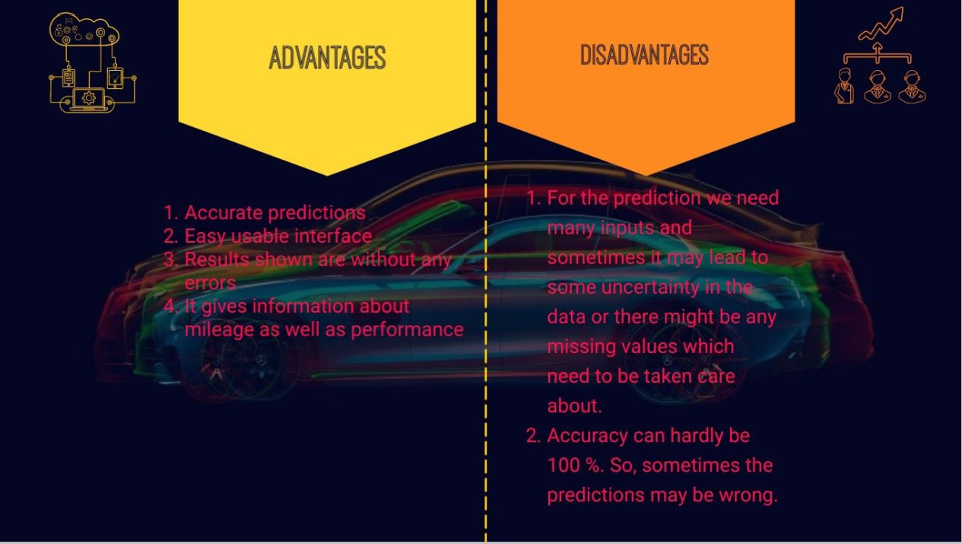

Slide 13
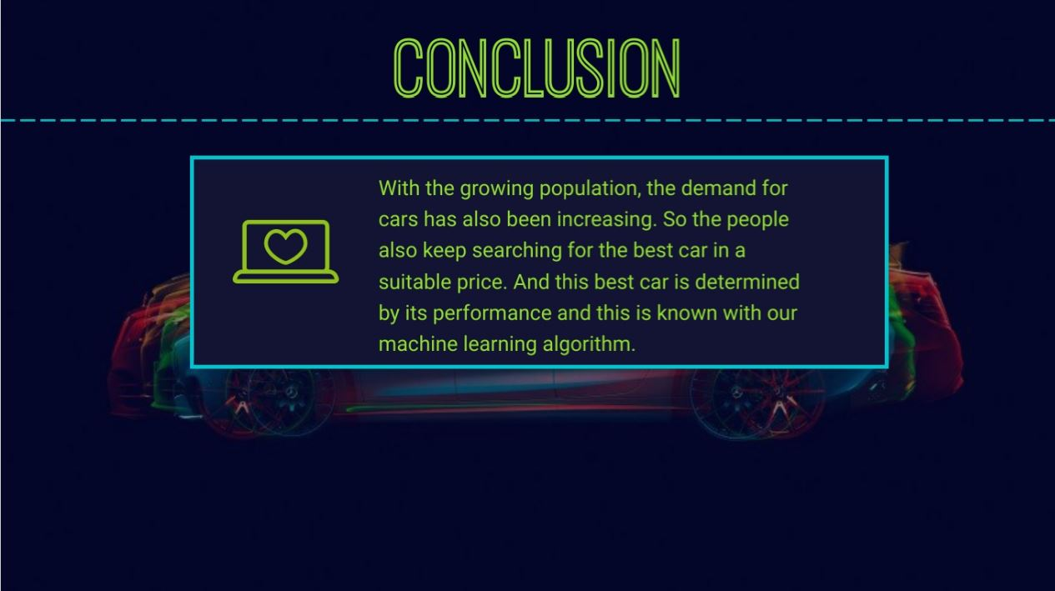

Slide 14
Teammates
Ch Preethi 18481A0544
K Bhargavi 18481A0527
A Vasavi Venkata Naga Durga 18481A0518
B Venkata Shiva 18481A0521
GitHub Link:https://github.com/smartinternz02/SI-GuidedProject-1995-1621672132
THANKYOU

